Slide 1

8th Grade Math: Pre-Algebra
Unit 3, Lesson 5 Adding and Subtracting Numbers Expressed in Scientific Notation Volume 1, pg. 101

Slide 2


Benchmarks
MA.8.NSO.1.5
Add, subtract, multiply, and divide numbers expressed in scientific notation with procedural fluency.
MA.8.NSO.1.6
Solve real-world problems involving operations with numbers expressed in scientific notation.
volume 1, pg. 101

Slide 3
Integrated Mathematical Thinking and Reasoning Standards
MA.K12.MTR.1.1 Actively participate in effortful learning both individually and collectively.
MA.K12.MTR.3.1 Complete tasks with mathematical fluency.
MA.K12.MTR.4.1 Engage in discussions that reflect on the mathematical thinking of self and others.
MA.K12.MTR.5.1 Use patterns and structure to help understand and connect mathematical concepts.
MA.K12.MTR.7.1 Apply mathematics to real-world contexts.
volume 1, pg. 101

Slide 4

Learning Targets
I can add and subtract numbers expressed in scientific notation.
I can solve real-world problems involving operations with numbers expressed in scientific notation.
volume 1, pg. 101

Slide 5

Warm-Up
volume 1, pg. 102

Slide 6


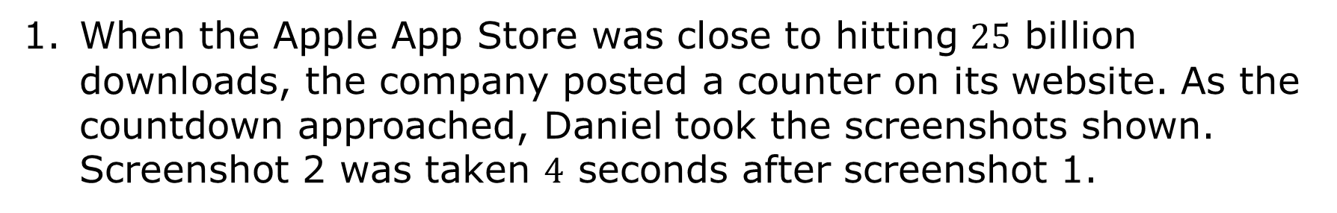
3.5.1 Warm-Up: 25 Billion Downloads!
When the Apple App Store was close to hitting $25$ billion downloads, the company posted a counter on its website. As the countdown approached, Daniel took the screenshots shown. Screenshot 2 was taken $4$ seconds after screenshot 1.
Screenshot 1
Screenshot 2
volume 1, pg. 102
Notes:
Video Link: https://algebranation.wistia.com/medias/fi4fidi5y8

Slide 7
What do you notice?
What do you wonder?
volume 1, pg. 102
Notes:
Video Link: https://algebranation.wistia.com/medias/fi4fidi5y8

Slide 8

Exploration
volume 1, pg. 102

Slide 9

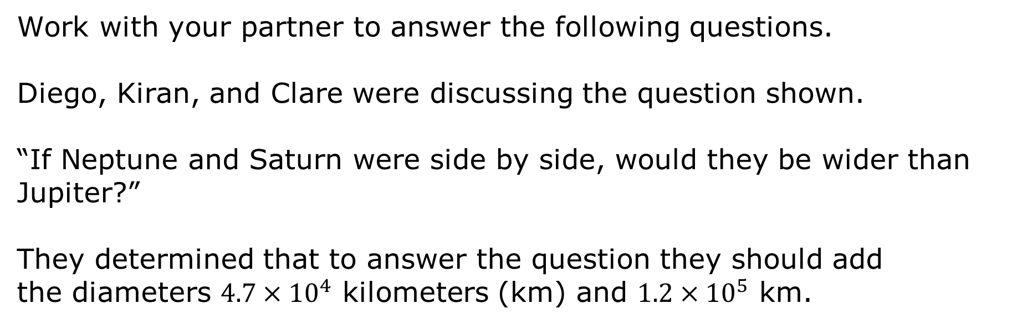
3.5.2 Exploration: Measuring the Planets
Work with your partner to answer the following questions.
Diego, Kiran, and Clare were discussing the question shown.
“If Neptune and Saturn were side by side, would they be wider than Jupiter?”
They determined that to answer the question they should add the diameters $4.7×{10}^{4}$ kilometers (km) and $1.2×{10}^{5}$ km.
volume 1, pg. 102

Slide 10
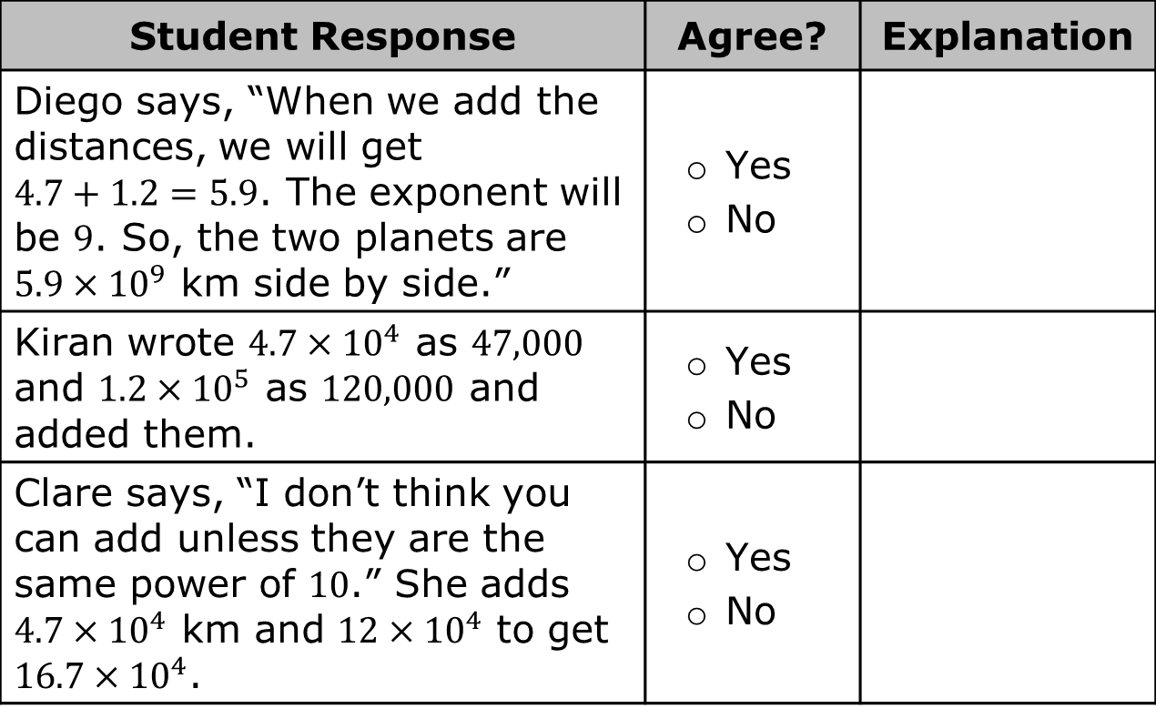
Review each student’s response, then complete the table.
Student Response | Agree? | Explanation
Diego says, “When we add the distances, we will get $4.7+1.2=5.9$. The exponent will be $9$. So, the two planets are $5.9×{10}^{9}$ km side by side.” | Yes No
Kiran wrote $4.7×{10}^{4}$ as $47,000$ and $1.2×{10}^{5}$ as $120,000$ and added them. | Yes No
Clare says, “I don’t think you can add unless they are the same power of $10$.” She adds $4.7×{10}^{4}$ km and $12×{10}^{4}$ to get $16.7×{10}^{4}$. | Yes No
volume 1, pg. 103

Slide 11
Jupiter has a diameter of $1.43×{10}^{5}$. Which is wider: Neptune and Saturn placed side by side, or Jupiter?
volume 1, pg. 103

Slide 12

Guided Instruction
volume 1, pg. 103

Slide 13

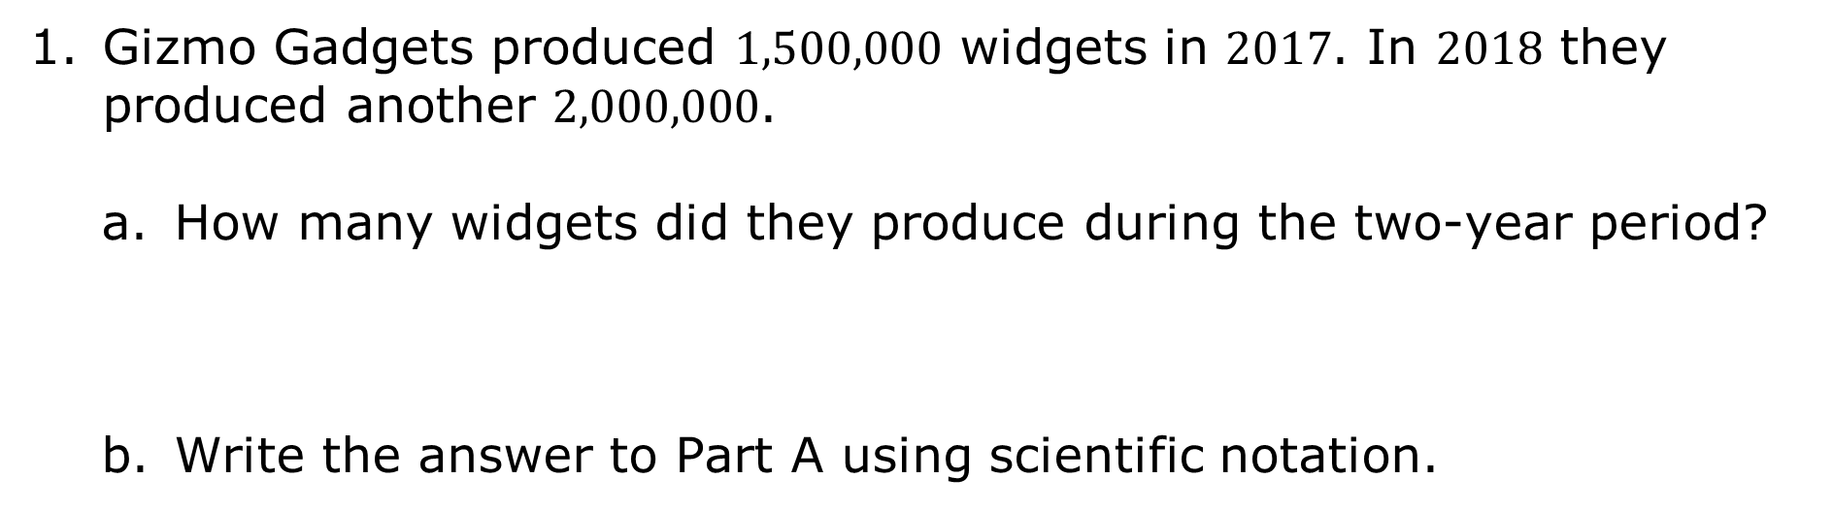
3.5.3 Guided Instruction: Adding and Subtracting Numbers in Scientific Notation
Gizmo Gadgets produced $1,500,000$ widgets in $2017$. In $2018$ they produced another $2,000,000$.
How many widgets did they produce during the two-year period?
Write the answer to Part A using scientific notation.
volume 1, pg. 103

Slide 14
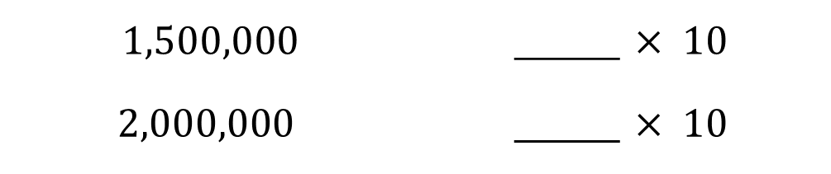
Scientific notation can be used to add and subtract large and small numbers.
Write the numbers in scientific notation.
$$1,500,000$$ | ____ $× {10}^{ }$
$$2,000,000$$ | ____ $× {10}^{ }$
volume 1, pg. 103

Slide 15
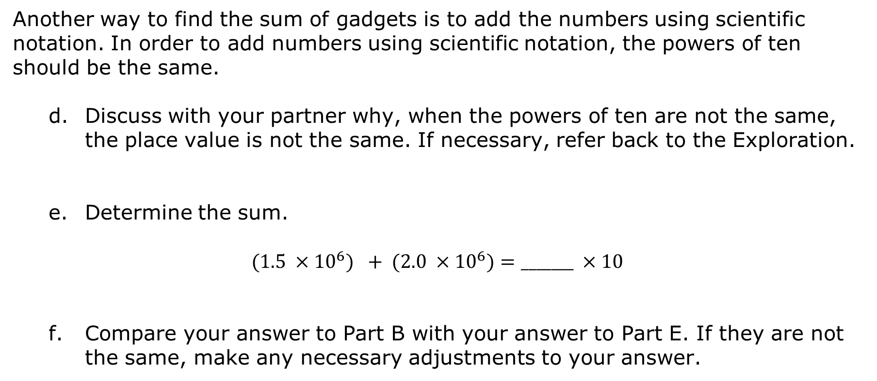
Another way to find the sum of gadgets is to add the numbers using scientific notation. In order to add numbers using scientific notation, the powers of ten should be the same.
Discuss with your partner why, when the powers of ten are not the same, the place value is not the same. If necessary, refer back to the Exploration.
Determine the sum.
$$(1.5 ×{10}^{6}) + (2.0 ×{10}^{6})=_______ ×{10}^{ }$$
Compare your answer to Part B with your answer to Part E. If they are not the same, make any necessary adjustments to your answer.
volume 1, pg. 103

Slide 16

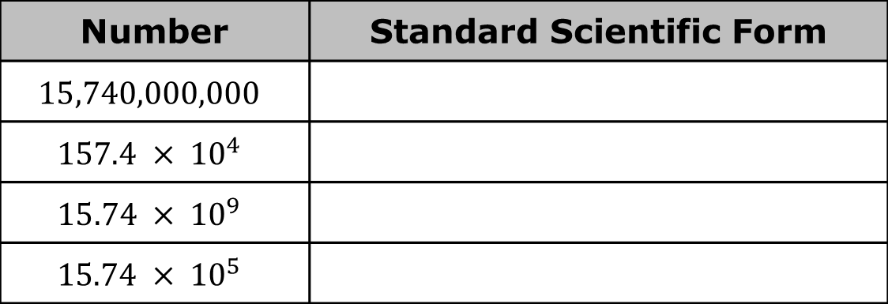
Write each in standard form.
Which numbers in problem $2$ are represented by the same standard scientific form?
Number | Standard Scientific Form
$$15,740,000,000$$
$$157.4 × {10}^{4}$$
$$15.74 × {10}^{9}$$
$$15.74 × {10}^{5}$$
volume 1, pg. 104

Slide 17
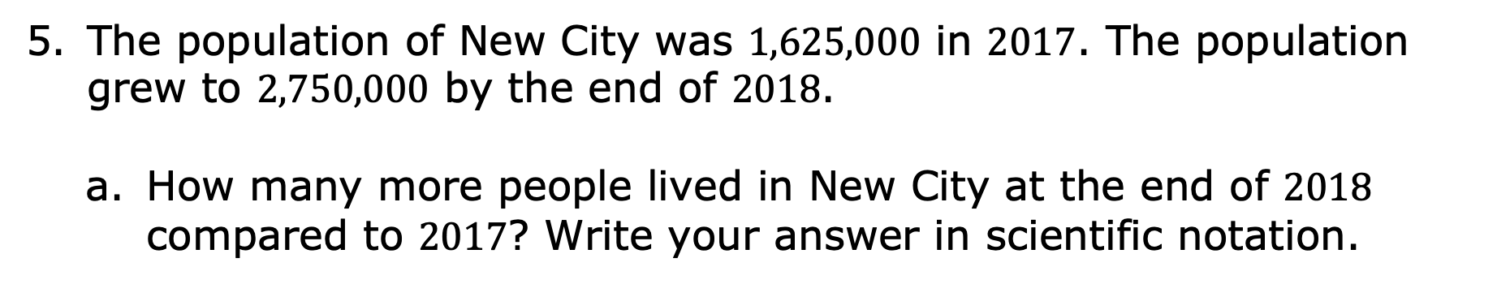
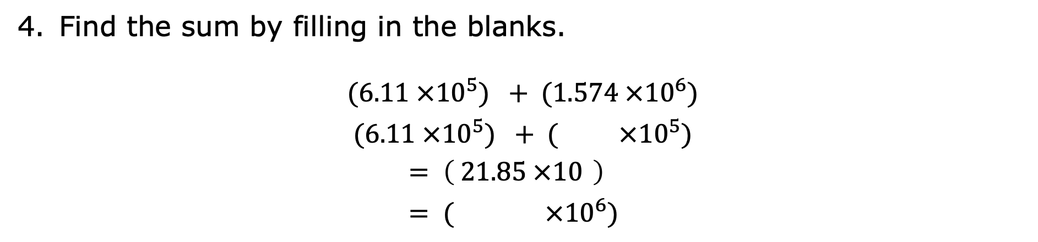
Find the sum by filling in the blanks.
$$(6.11 ×{10}^{5}) + (1.574 ×{10}^{6})$$
$$(6.11 ×{10}^{5}) + ( ×{10}^{5})$$
$= \left( 21.85 ×{10}^{ }\right)$
$= ( ×{10}^{6})$
The population of New City was $1,625,000$ in $2017$. The population grew to $2,750,000$ by the end of $2018$.
How many more people lived in New City at the end of $2018$ compared to $2017$? Write your answer in scientific notation.
volume 1, pg. 104

Slide 18
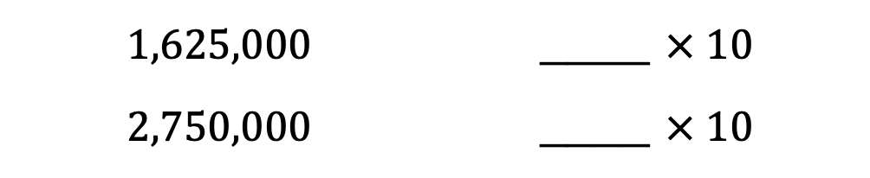
Write the population numbers from the word problem in scientific notation.
$$1,625,000$$ | ____ $× {10}^{ }$
$2,750,000$ | ____ $× {10}^{ }$
What is the difference between the populations? Write your answer using scientific notation.
volume 1, pg. 104

Slide 19
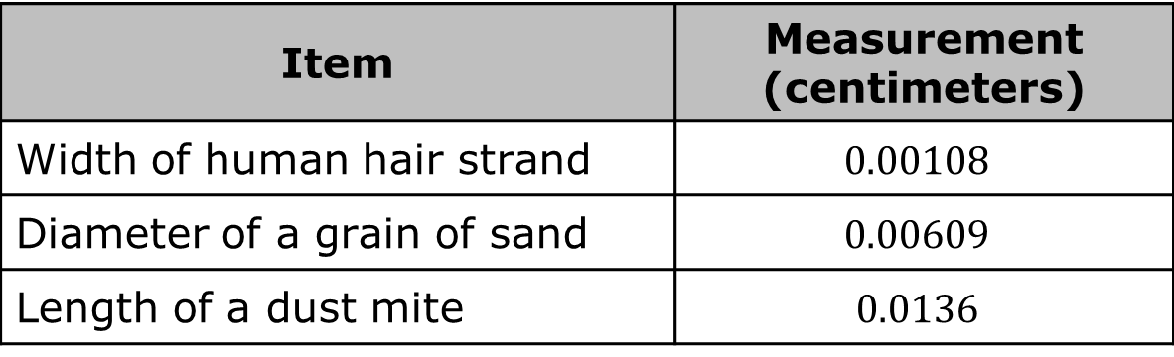
Clare was wondering if adding and subtracting numbers in scientific notation would hold true for small numbers as well. The measurements in the table are from her science textbook.
Item | Measurement (centimeters)
Width of human hair strand | $$0.00108$$
Diameter of a grain of sand | $$0.00609$$
Length of a dust mite | $$0.0136$$
volume 1, pg. 105

Slide 20
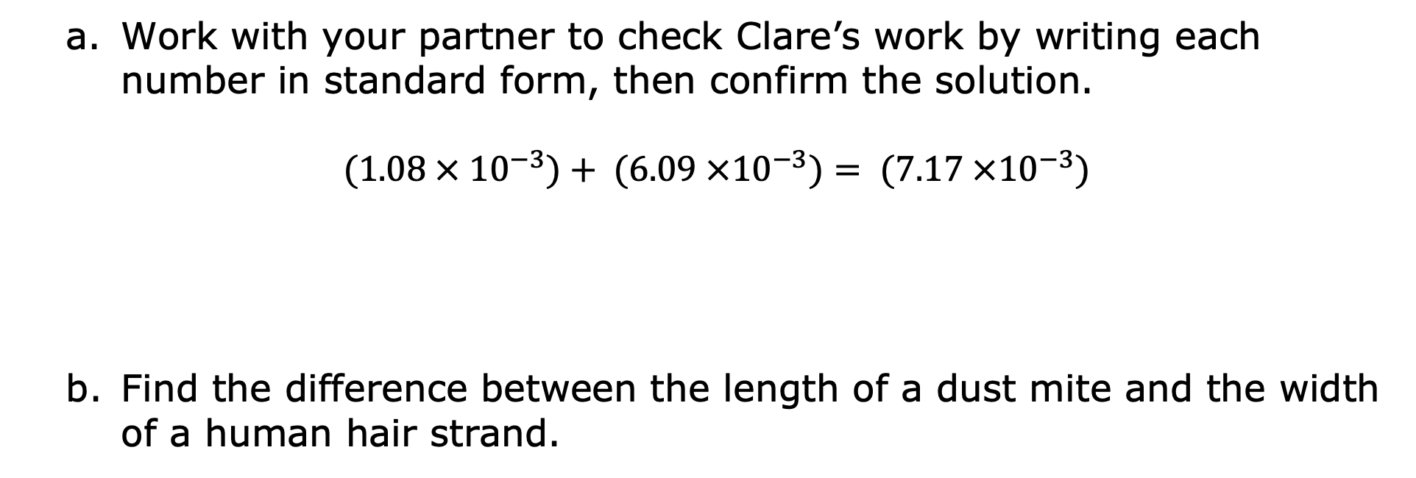
Work with your partner to check Clare’s work by writing each number in standard form, then confirm the solution.
$(1.08 × {10}^{−3})+ (6.09 ×{10}^{−3})= (7.17 ×{10}^{−3})$
Find the difference between the length of a dust mite and the width of a human hair strand.
volume 1, pg. 105

Slide 21

Guided Practice
volume 1, pg. 105

Slide 22

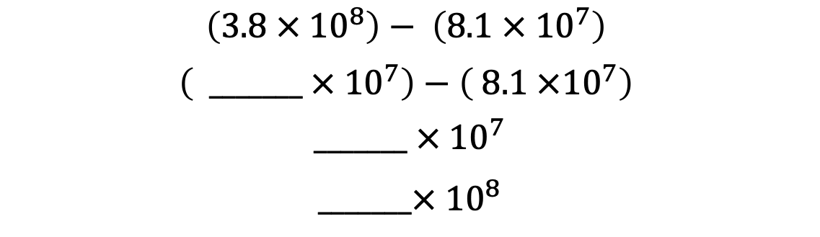
3.5.4 Guided Practice: Adding and Subtracting Numbers Written in Scientific Notation
Fill in the blanks to find the difference.
$$\left(3.8 × {10}^{8}\right)− \left(8.1 × {10}^{7}\right)$$
$$\left( _______ × {10}^{7}\right)−\left( 8.1 ×{10}^{7}\right)$$
$$_______ × {10}^{7}$$
$$_______× {10}^{8}$$
volume 1, pg. 105

Slide 23
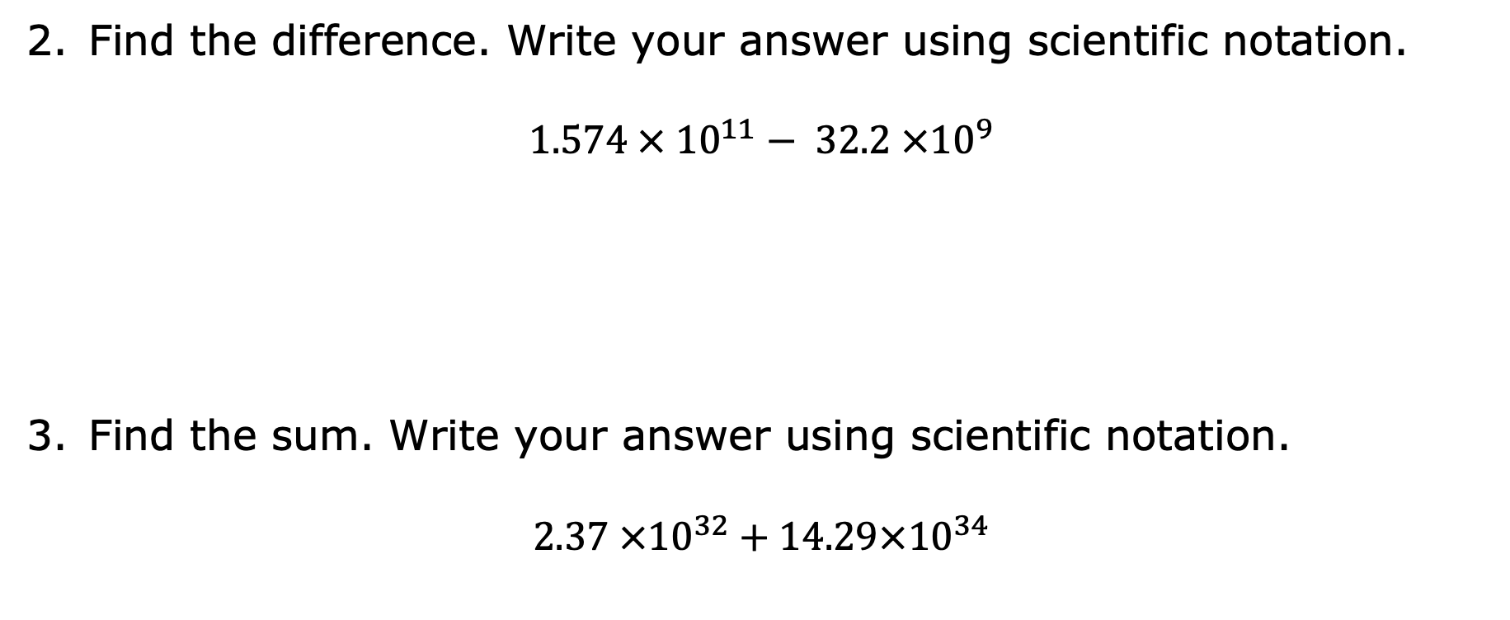
Find the difference. Write your answer using scientific notation.
$$1.574 × {10}^{11}− 32.2 ×{10}^{9}$$
Find the sum. Write your answer using scientific notation.
$$2.37 ×{10}^{32}+14.29×{10}^{34}$$
volume 1, pg. 105

Slide 24

Try It
volume 1, pg. 106

Slide 25

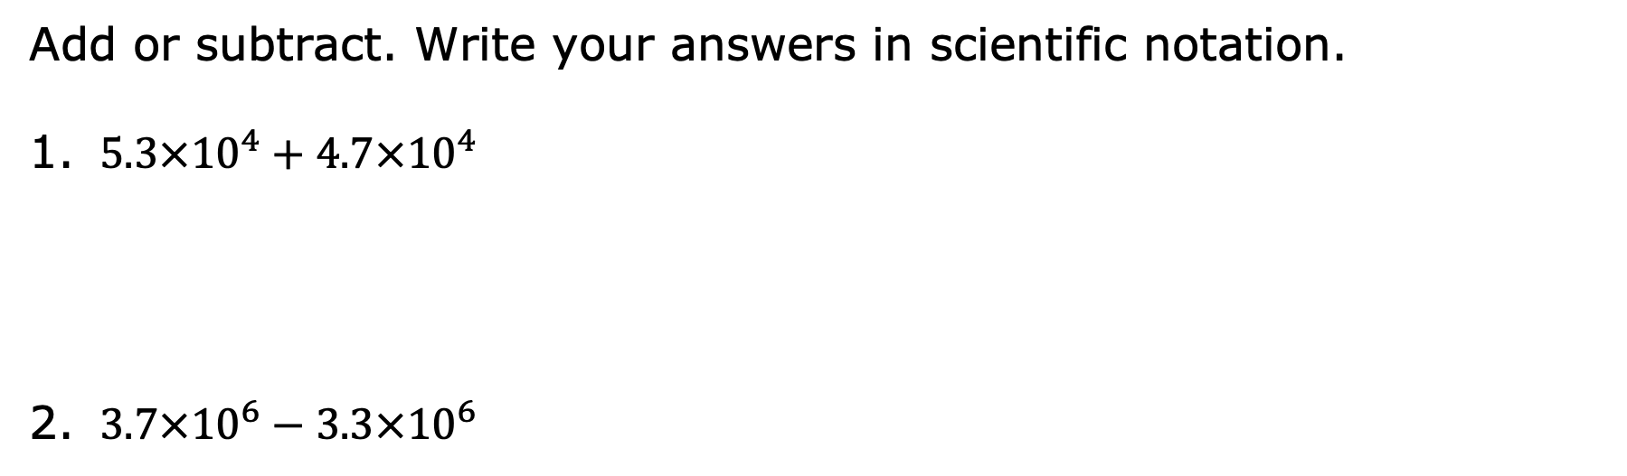
3.5.5 Try It: Adding and Subtracting Numbers Written in Scientific Notation
Add or subtract. Write your answers in scientific notation.
$5.3×{10}^{4}+4.7×{10}^{4}$
$3.7×{10}^{6}−3.3×{10}^{6}$
volume 1, pg. 106

Slide 26

$4.8×{10}^{−3}+6.3×{10}^{−3}$
$6.6×{10}^{−5}−6.1×{10}^{−5}$
volume 1, pg. 106

Slide 27
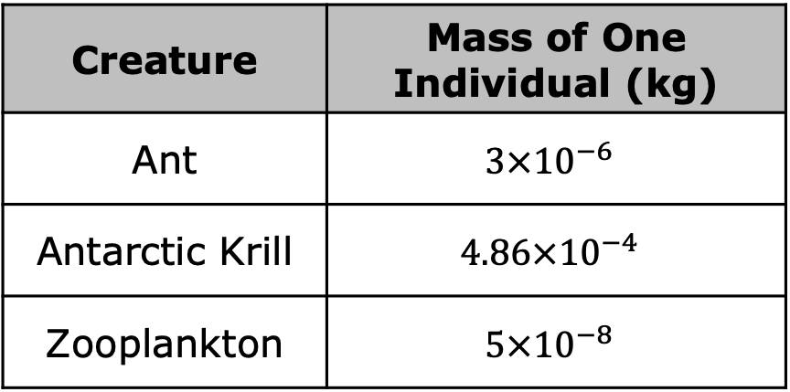
The table lists the masses, in kilograms (kg), of different creatures on land and in water. Use this information to answer the questions.
Creature | Mass of One Individual (kg)
Ant | $$3×{10}^{−6}$$
Antarctic Krill | $$4.86×{10}^{−4}$$
Zooplankton | $$5×{10}^{−8}$$
What is the difference, in kg, between the mass of an ant and the mass of an Antarctic krill?
What is the total mass of an ant and a zooplankton?
volume 1, pg. 106

Slide 28

Wrap-Up
volume 1, pg. 107

Slide 29

3.5.6 Wrap-Up: Reflection
What was the muddiest (most difficult or confusing) point in today’s lesson on adding and subtracting numbers expressed in scientific notation?
volume 1, pg. 107

